Slide 1

PROJECT : ZOMATO
SPREADSHEET
ANALYSIS
Spreadsheet Project:
Zomato Restaurants Analysis

Slide 2
PROBLEM
STATEMENT
OBJECTIVES
DATA DESCRIPTION & METHODOLOGY
KEY METRICS & VISUALIZATION

Slide 3

PROBLEM STATEMENT
Zomato is seeking to expand its presence by identifying new strategic locations for restaurant openings. This project utilizes data-driven insights to suggest optimal areas for expansion based on ratings, price, votes and cuisines.

Slide 4
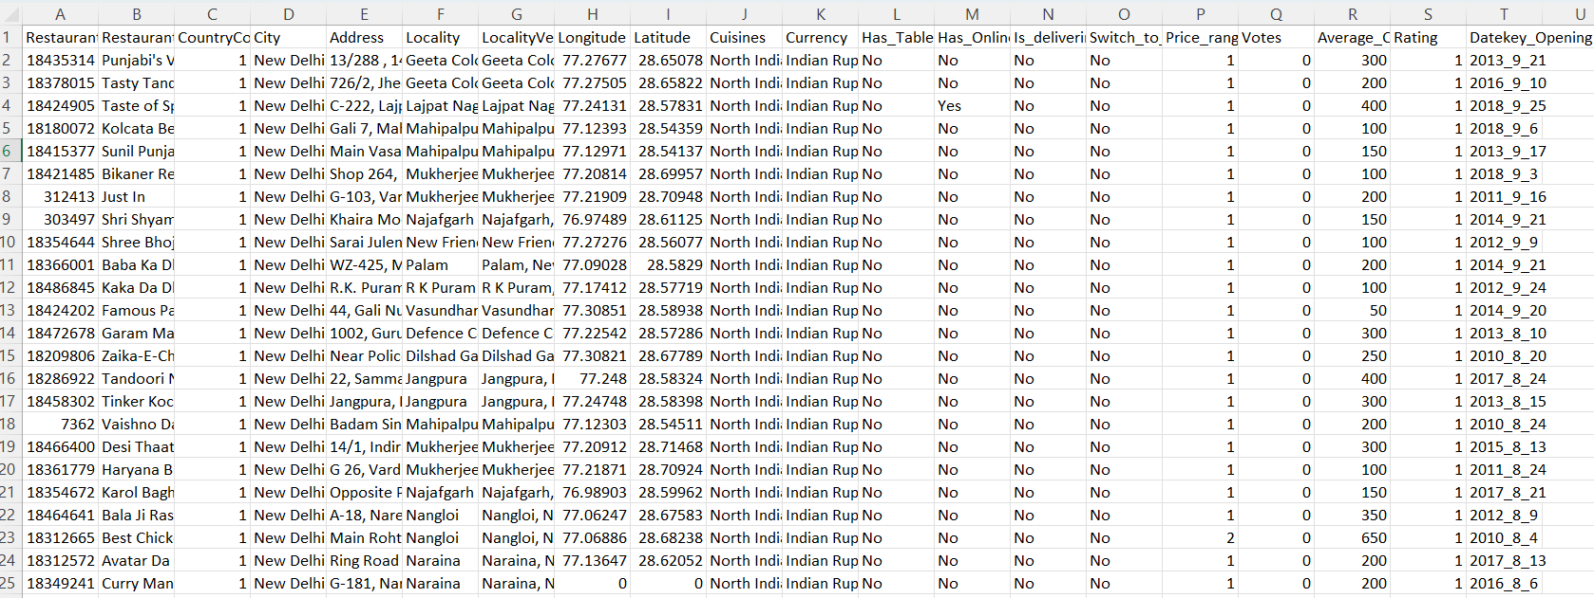
You are hired as a consultant data analyst by Zomato where the team is looking for expansion and opening more restaurants. Your task is to develop strategies/suggestions for opening newer restaurants .

Slide 5
OBJECTIVES
Identify high-potential countries for Zomato’s international expansion by analyzing global market trends and growth indicators.
Examine market patterns, including cuisine preferences, competitive presence, and demographic behavior, to understand emerging opportunities.
Study restaurant distribution across regions to assess supply gaps, saturation levels, and partnership potential.
Analyze customer feedback, reviews, and pricing models to evaluate consumer expectations and spending behavior.
Improve service delivery by systematically collecting customer satisfaction data and leveraging insights to enhance user experience.

Slide 6
DATA OVERVIEW
Restaurant ID: Unique identifier for each restaurant.
Restaurant Name: The name of the restaurant.
CountryCode: Country code of the location where the restaurant is situated.
City: The city where the restaurant is located.
Address: The specific address of the restaurant.
Locality: The locality or neighborhood where the restaurant is situated.
Locality Verbose: Detailed information about the locality.
Longitude: The geographical longitude coordinate of the restaurant.
Latitude: The geographical latitude coordinate of the restaurant.
Cuisines: The type of cuisine offered by the restaurant.
Currency: The currency used for transactions in the restaurant.
Datekey_opening: The date when the restaurant was opened.
Has_Table_booking: Indicates whether the restaurant has a table booking option (Yes/No).
Has_Online_delivery: Indicates whether the restaurant offers online delivery (Yes/No).
Is_delivering_now: Indicates whether the restaurant is currently delivering (Yes/No).
Switch_to_order_menu: Indicates whether users can switch to the order menu (Yes/No).
Price_range: A numeric value indicating the price range category of the restaurant.
Votes: The number of votes or ratings/(feedback) received by the restaurant.
Average_Cost_for_two: The average cost for two people dining at the restaurant.
Rating: The overall rating of the restaurant is based on user reviews.

Slide 7
DATA SNAPSHOT
Total Restaurants | 9551
Total Countries | 16
Total Cities | 140
Total cuisines | 1821
Service offered | Online Booking, Table Booking
Average Rating | 2.89
Average price in INR | ₹863

Slide 8
METHODOLOGY
Data Cleaning:
Resolved missing values in the Cuisine column to ensure consistency and accuracy.
Removed redundant and irrelevant columns to streamline the dataset and improve overall usability.
Data Enrichment:
Added meaningful context to the dataset by mapping each country code to its corresponding country name using VLOOKUP.
Extracted the year from the date key opening field using text functions, enabling effective analysis of year-wise trends and patterns.
Descriptive Analysis:
Utilized pivot tables to summarize key metrics and uncover relationships within the data.
Created pivot charts to visually represent insights, making complex information easy to interpret and supporting data-driven decision-making.

Slide 9
KEY METRICS AND VISUALIZATION
Calculated the total number of restaurants per country and visualized the insights through charts.
It is advisable to open new restaurants in Brazil, Sri Lanka, Canada, and Australia.

Slide 10
AVERAGE VOTERS PER COUNTRY
Calculated the average number of voters per restaurant by country for comparative analysis. A country with significant proportion of voters indicates more interaction with customers.
Example from Chart: Indonesia, UAE, Turkey.

Slide 11
RESTAURANTS OPENED EACH YEAR
A higher number of restaurants suggests greater consumer involvement. Example from Chart: Years 2011, 2017, and 2018

Slide 12
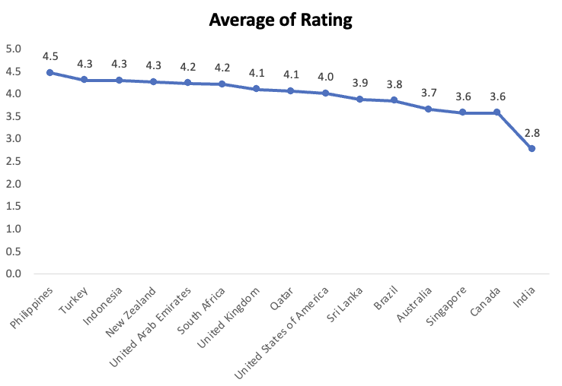
AVERAGE OF RATING
It is mandatory to understand ratings of restaurants in order to develop marketing plans and assess performance.
High rating: Philippines, Turkey [These countries face major market demands].
Low rating: Canada, Singapore [Improvements must be made]

Slide 13
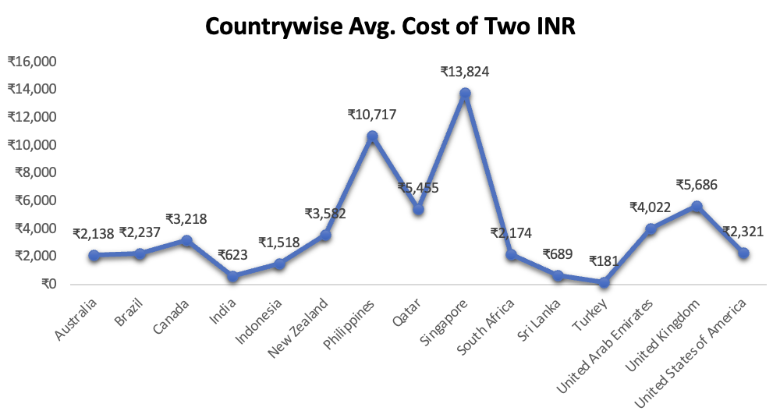
Singapore is the most expensive, averaging .
India and the UAE offer the most affordable dining.
Only Singapore and the Philippines (over ) exceed this threshold.
The UK is over double the cost of the USA, showing major differences even within key markets.

Slide 14
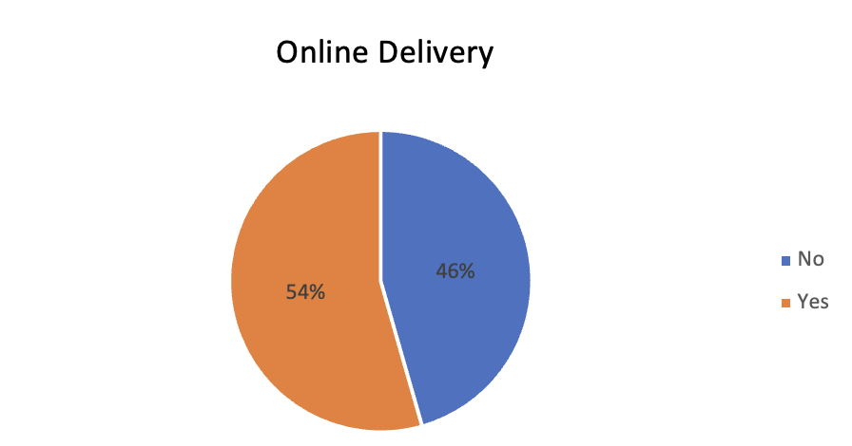
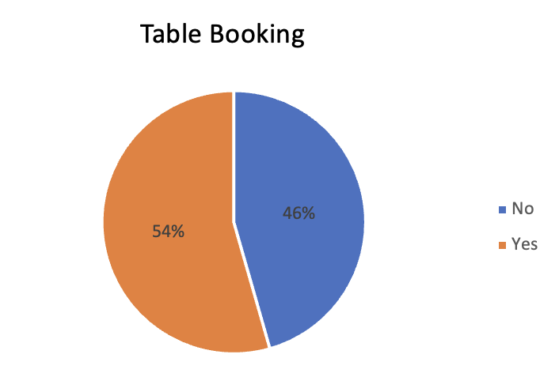
DELIVERY AND TABLE BOOKING ANALYSIS
Restaurants with online delivery and table booking have slightly better average ratings.
Having an online presence caters to more people and increases the overall rating.
New restaurants should offer at least table booking or online delivery—ideally both—to improve ratings.

Slide 15
RECOMMENDATION
Focus on opening new restaurants in countries with strong potential and healthy competition.
Prioritise markets with fewer existing eateries for easier entry.
Use restaurant density analysis to spot growth opportunities and prime customer locations.
Identify major competitors to inform strategies for differentiating new venues.
Understand customer sentiment to guide improvements.
Provide quality food and smart pricing to attract and retain customers.
Implement online delivery and booking systems to boost satisfaction and ratings.

Slide 16
CONCLUSION
An in-depth examination of restaurant data has shown a number of promising prospects for international growth.
We can strategically place ourselves in markets with less competition by concentrating on nations with high average ratings and smaller restaurant densities.
North Indian, Chinese, Fast Food, Café, Bakery, Desserts, Street Food are the top cuisines available in restaurants across all countries.
Given their high levels of consumer satisfaction, targeting cities in the Sri Lanka and Indonesia has great promise.

Slide 17
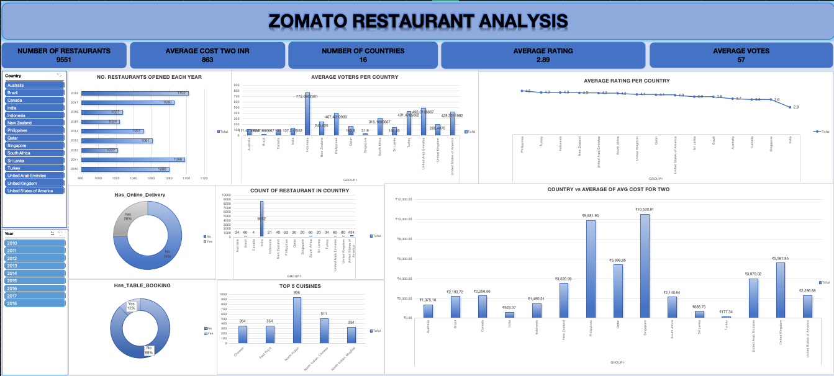

Slide 18


